Slide 1
A (hopefully) gentle introduction to pipeline analysis
Snakemake and Targets
08 Dec 2019 Plus
18 days to 2021

Slide 2
About me
Experienced trainer and passionate learner
I have taught myself how to use snakemake three times over the past 2 years
Sophisticated programmer
So sophisticated that I often write code that no one can debug
Workflow power user
Since my brain cannot process much information at all
Early adopter
Easily distracted by new tools
Open-source contributor
I submit issues because I can’t solve them by myself

Slide 3
Outline
Why use snakemake
How to use stankemake
What is `targets`

Slide 4
Data science is hard

Slide 5
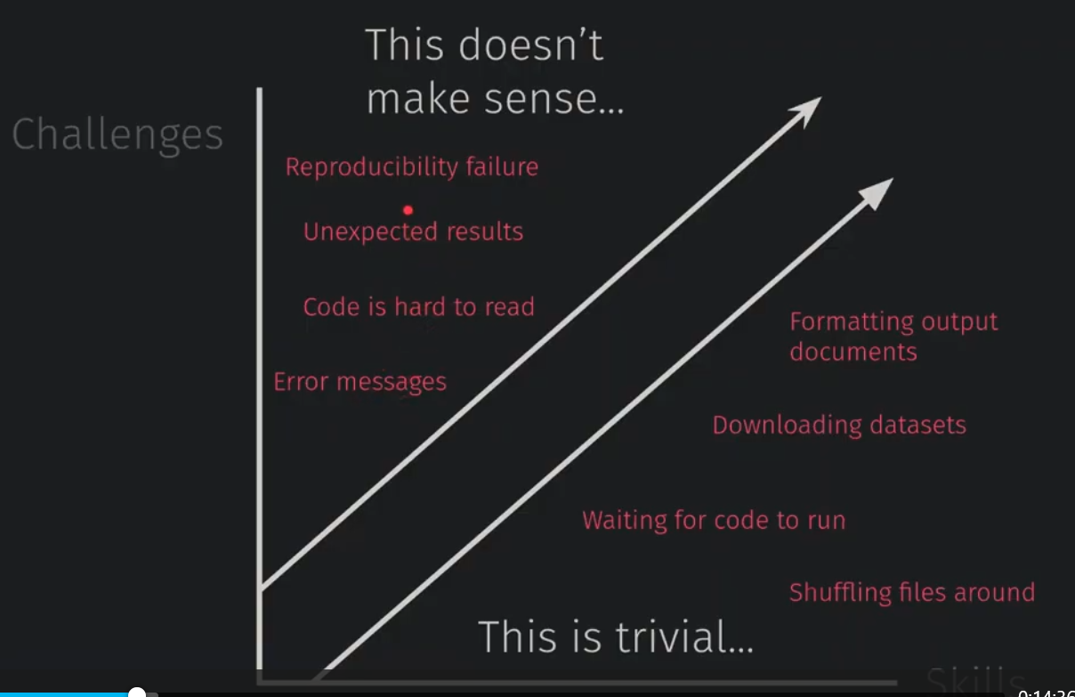
Skill

Slide 6


Slide 7


Slide 8
Workflow comes to rescue
A recipe that records each step of the analysis -> reproducibility
Detects the current state of the project and resume -> speed
Visualise the dependencies of one step on others -> clarity

Slide 9


Slide 10
Snakemake Official slides
Notes:
Python script:
I can use this today and see if I can do a demo on this
wrappers: instead of using tool + options, it includes all options in one package
Temp(): these files will be deleted once jobs dependent on them are done
Protected(): snakemake will add write protect to these files to prevent them from being deleted accidentally
Save some disk IO

Slide 11


Slide 12
Targets
Based in R
Data management ☺
Integrate well with tools built for cluster computing ☺
More stringent checks that re-run the pipeline when scripts/input changes ☺

Slide 13
Caveats
Gall’s law: complex systems are built from working simple systems
Iterative approach
Liu’ law: all tools are written by humans (as of now) and therefore all tools can be buggy.
No restart computer does not (always) help.
Please cite (Liu, 2019+)
Users’ Anguish
I do not know how the tool works -> read documentations
(which can be incomplete)
The developer does not know how I work -> no such functionality
The developer does not know how the tool works -> bug

Slide 14
Things did help:
Reduce the complexity
Farm -> local computer
Snakemake -> test out bash command itself
Wildcard -> single samples
These steps will also be helpful to produce reproducible examples (reprex)
Submit GitHub issues (often requires reprex)
Ask (snakemake: stackoverflow; targets: github issues)
Exercise
Meditate
Sleep

Slide 15
Thank you

